Slide 1


RESEARCH PROPOSAL PRESENTATION
Implementing Deep Learning tools and techniques in traffic accident prediction.
Yassir Ibararh
MSc Artificial Intelligence
University of Essex Online
Research Methods and Professional Practice

Slide 2

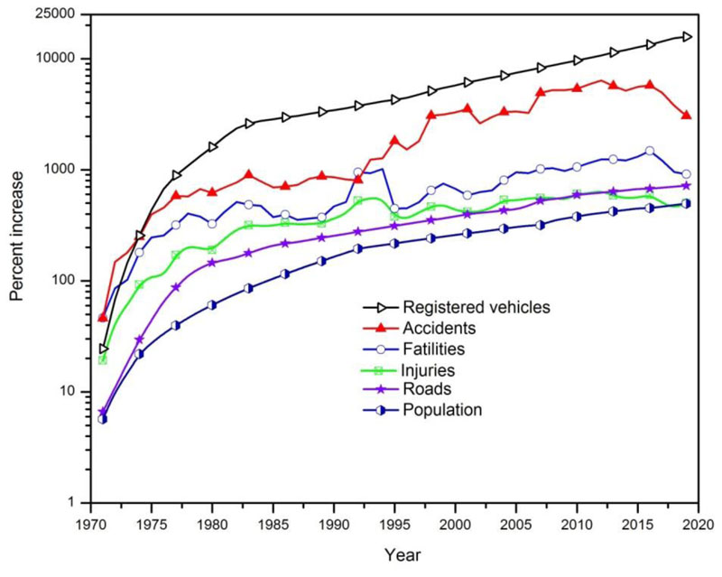
Traffic accidents
3.9 Million traffic accidents between 2015 and 2022.
First reason of death among people aged between 16 and 24 in the US.
Data models predict the total number of accidents is expected to keep rising with the current techniques.
Citations: (WHO, 2023; FHTSA, 2025; NHTSA, 2022; Jin et al., 2023; Shakil et al., 2023)
FIGURE 1 | National Highway Traffic Safety Administration Accident statistics

Slide 3
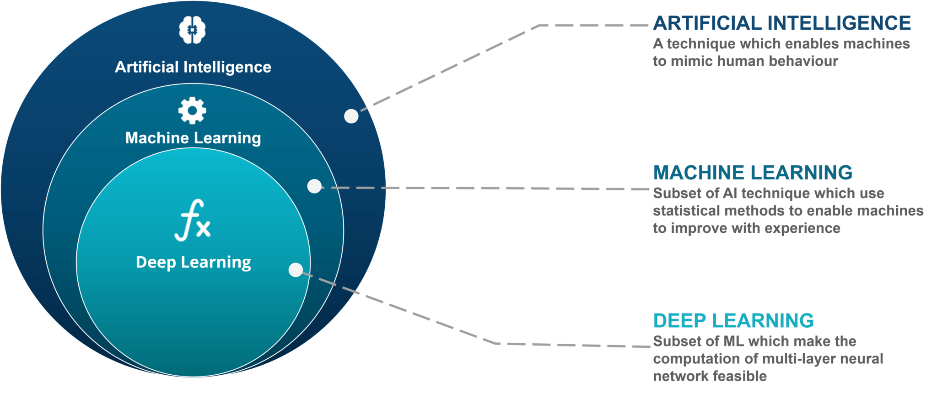
Deep Learning
Citations: (Ongsulee, 2017; Honglei et al., 2018; Sameen et al., 2017)

Slide 4
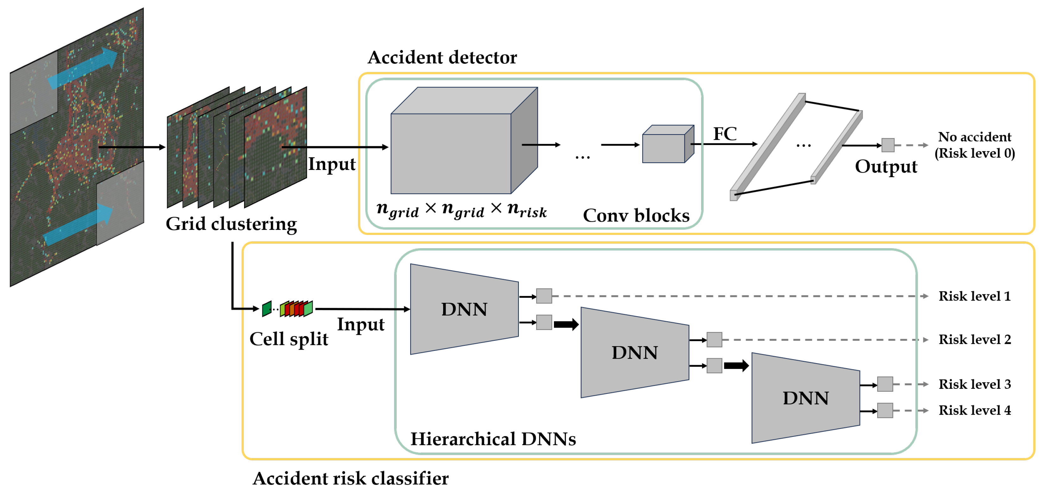
Deep Learning in Traffic accidents
Emerged as a possible alternative.
Automatically learns hierarchical features from large and complex traffic datasets.
Techniques such as CNNs, RNNs, and GNNs are now being explored to enhance prediction accuracy.
Citations: (Theofilatos et al., 2019; Sameen et al., 2017)

Slide 5

Research Question
How effective are deep learning techniques in improving the accuracy of traffic accident prediction?
Citations: (Varghese et al., 2020)

Slide 6
Aims and Objectives
Aim:
- Analyse the impact of implementing Deep learning techniques in traffic accidents prediction.
Objectives:
- Review existing literature
- Understand deep learning.
- Identify current and potential use cases.
- Uncover key trends, challenges, and opportunities.

Slide 7
Key literature related to the project
(Zheng et al., 2021): Modeling traffic conflicts for use in road safety analysis: A review of analytic methods and future directions
(Jin et al., 2023): From Prediction to Prevention: Leveraging Deep Learning in Traffic Accident Prediction Systems
(Dong et al., 2018): An Improved Deep Learning Model for Traffic Crash Prediction
(Zhouoning et al., 2018): Hetero-ConvLSTM: A Deep Learning Approach to Traffic Accident Prediction on Heterogeneous Spatio-Temporal Data
(Zhidan, et al., 2020): Urban Traffic Prediction from Mobility Data Using Deep Learning

Slide 8
Methodology
Research development:
- Secondary research: gather, analyse, interpret, present.
- Published and peer-reviewed papers are prioritised.
- Justify the use of deep learning over the traditional methods.
Application development:
- Follows SLDC.
- Trained using supervised learning model.
- Rigorous testing.
- Frames the scope for the application development.
- Quality assurance
Citations: (Dawson, 2015; Saunders et al., 2019; Prabhu, 2019)

Slide 9
Ethical Considerations & Risk Assessment
Ethical considerations:
- Examine concerns regarding real-world users and data.
- Ensure the model is free from bias and implications
Risk Assessment:
- Storage and handling of sensitive data.
- Risk of inaccuracy.
- Data curation methods.
Citations: (Prabhu, 2019; Rhem, 2023; DPIA, 2025; Abduljabbar et al., 2018; DFT, 2024)

Slide 10
Artifacts
Report:
Introduction:
Deep learning in traffic accidents prediction context
Literature review:
Academic papers and theories
Methodology:
Decision making process and the final design
Findings:
Visualisation and summary of data
Discussion:
Analyse findings, discuss issues, and opportunities.
Conclusion:
Understanding the impact
Presentation:
Technical walkthrough of how the model works
Live testing on real-world data
Model evaluation
Citations: (Dawson, 2015; UOEO, N.D)

Slide 11
Timeline
0-10 weeks
Literature Review and System Design
10-15 weeks
Research paper
15-25 weeks
System development and testing
25-26 weeks
Preparing the presentation
26 weeks
Research Submitted
Citations: (Dawson, 2015; Bayesteh, 2024)

Slide 12
Conclusion
Topic is critical due to concerns about road safety.
Learning outcomes:
Ability to do problem solving using deep learning models.
Developing research and analytical skills.
Understanding data management.
Understanding ethics of fairness, transparency and explainability.

Slide 13

Thank you for watching
Any questions?

Slide 14
References
Abduljabbar, R., Dia, H., Liyanage, S. and Bagloee, S.A. (2019) ‘Applications of Artificial Intelligence in Transport: An Overview’, Sustainability, 11(1), pp. 189. Available at: https://doi.org/10.3390/su11010189
Ahmed, S., Hossain, M.A., Ray, S.K., Bhuiyan, M.M.I. and Sabuj, S.R. (2023) ‘A study on road accident prediction and contributing factors using explainable machine learning models: analysis and performance’, Transportation Research Interdisciplinary Perspectives, 19(100814). Available at: https://doi.org/10.1016/j.trip.2023.100814
AI-Dogom, D., Aburaed, N., AI-Saad, M. and Almansoori, S. (2019) ‘Spatio-temporal Analysis and Machine Learning for Traffic Accidents Prediction’, 2nd International Conference on Signal Processing and Information Security (ICSPIS). IEEE: Publisher, pp. 1-5. Available at: https://ieeexplore.ieee.org/document/9045892
Bayesteh, A. (2024) ‘Agile-Based Optimized Planning and Scheduling Methodology for Multiple Scattered Projects’, PhD thesis, University of Alberta. Available at: http://doi.org/10.7939/r3-sywn-m748 (Accessed: 7 July 2025).
Dawson, C.W. (2015) Projects in Computing and Information Systems. 3rd ed. Harlow: Pearson.
Dong, C., Shao, C., Li, J. and Xiong, Z. (2018) ‘An Improved Deep Learning Model for Traffic Crash Prediction’, Journal of Advanced Transportation. Available at: https://doi.org/10.1155/2018/3869106 (Accessed: 07 July 2025).
Google Scholar (N.D.) Google Scholar. Available from: https://scholar.google.co.uk/ (Accessed 06 July 2025).
Information Commissioner’s Office (2025). Data Protection Impact Assessments (DPIAs): UK GDPR guidance and resources. Information Commissioner’s Office. Available at: https://ico.org.uk/for-organisations/uk-gdpr-guidance-and-resources/accountability-and-governance/data-protection-impact-assessments-dpias/ (Accessed: 07 July 2025).
Sameen, M.I. and Pradhan, B. (2017) ‘Severity prediction of traffic accidents with recurrent neural networks’, Applied Sciences 7(6), pp. 476-486. Available at: https://doi.org/10.3390/app7060476

Slide 15
References
Insurance Institute for Highway Safety & Highway Loss Data Institute (2025). Fatality Facts 2023: State by State. Insurance Institute for Highway Safety. Available at: https://www.iihs.org/research-areas/fatality-statistics/detail/state-by-state (Accessed: 07 July 2025).
Jin, Z. and Noh, B. (2023) ‘From Prediction to Prevention: Leveraging Deep Learning in Traffic Accident Prediction Systems’, Electronics 12(20), pp. 4335. Available at: https://doi.org/10.3390/electronics12204335
Liu, Z., Li, Z., Wu, K. and Li, M. (2018) ‘Urban Traffic Prediction from Mobility Data Using Deep Learning’, in IEEE Network. IEEE: Publisher, pp. 40-46. Available at: https://ieeexplore.ieee.org/document/8425299
WHO (2023) ‘Global status report on road safety 2023: country and territory profiles’, Social Determinants of Health (SDH), pp. 126-179 Available at: https://www.who.int/publications/i/item/9789240087712
Ongsulee, P. (2017) ‘Artificial intelligence, machine learning and deep learning’, 15th International Conference on ICT and Knowledge Engineering (ICT&KE). IEEE: Publisher, pp. 1-6. Available at: http://doi: 10.1109/ICTKE.2017.8259629
Prabhu, S.P. (2019) ‘Ethical challenges of machine learning and deep learning algorithms’, The Lancet Oncology, 20(5), pp. 621-622. Available at: https://www.thelancet.com/journals/lanonc/article/PIIS1470-2045(19)30230-X/abstract
Ren, H., Song, Y., Wang, J., Hu, Y. and Lei, J. (2018) ‘A Deep Learning Approach to the Citywide Traffic Accident Risk Prediction’, 21st International Conference on Intelligent Transportation Systems (ITSC). IEEE: Publisher, pp. 1380-1385. Available at: http://doi:10.1109/ITSC.2018.8569437
Rhem, A.J. (2023) ‘Ethical Use of Data in AI Applications’, Ethics - Scientific Research, Ethical Issues, Artificial Intelligence and Education. Available at: https://www.intechopen.com/chapters/1121510 (Accessed: 07 July 2025).

Slide 16
References
Saunders, M.N.K., Lewis, P. and Thornhill, A. (2019) Research Methods for Business Students. 8th ed. Harlow: Pearson.
Theofilatos, A., Chen, C. and Antoniou, C. (2019) ‘Comparing Machine Learning and Deep Learning Methods for Real-Time Crash Prediction’, Transportation Research Record 2673(8), pp. 169-178. Available at: https://doi.org/10.1177/0361198119841571
Varghese, V., Chikaraishi, M. and Urata, J. (2020) ‘Deep Learning in Transport Studies: A Meta-analysis on the Prediction Accuracy’, Journal of Big Data Analytics in Transportation 2, pp. 199-220. Available at: https://doi.org/10.1007/s42421-020-00030-z
Yuan, Z., Zhou, X. and Yang, T. (2018) ‘Hetero-ConvLSTM: A Deep Learning Approach to Traffic Accident Prediction on Heterogeneous Spatio-Temporal Data’, In Proceedings of the 24th ACM SIGKDD International Conference on Knowledge Discovery & Data Mining. London: UK, pp. 984–992. Available at: https://doi.org/10.1145/3219819.3219922
Zheng, L., Sayed, T. and Mannering, F. (2021) ‘Modeling traffic conflicts for use in road safety analysis: A review of analytic methods and future directions’, Analytic Methods in Accident Research, 29(100142). Available at: https://doi.org/10.1016/j.amar.2020.100142
Zhou, L., Pan, S., Wang, J., and Vasilakos, A.V. (2017) ‘Machine learning on big data: Opportunities and challenges’, Neurocomputing, 237(1) pp. 350-361 Available at: https://www.sciencedirect.com/science/article/pii/S0925231217300577

